Slide 1
Joining & Merging Data
Jeremy Bergmann - Omaha Data Science Academy

Slide 2
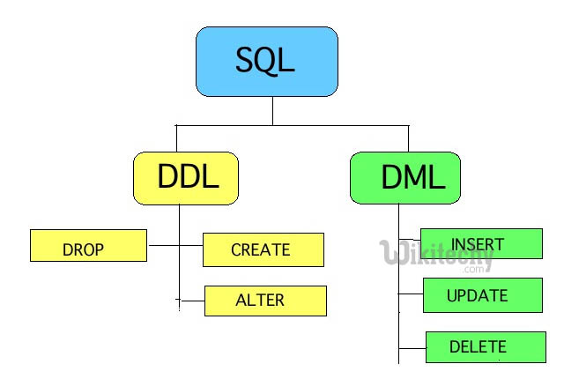
Class 3 Review – Data Storage
Data Storage
Create and delete databases
Create and delete tables & views
Create tables with constraints
Add and delete table fields
Add and delete table constraints
Insert, Update, Delete data from tables
Import data from SQL and CSV files
Notes:
Feynman technique: Learn -> Explain -> Reflect -> Repeat
What are the most important ideas from last class? Write a summary of the information as if explaining to a 14 year old. Avoid jargon Keep the words and sentences simple Rely on memory Make the explanation visual, if possible Note where you had difficulty or have knowledge gaps. These indicate things you should review, research, or ask questions about

Slide 3
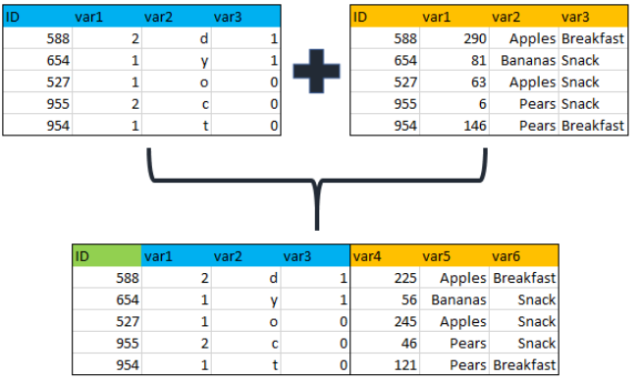
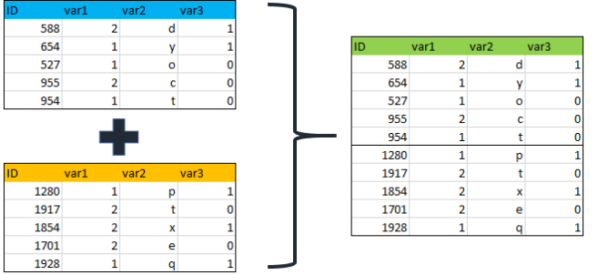
Class 4 Objectives
Joining & Merging Data
Joining Data - inner, outer and left Merging/Appending Data – Union/Union All
Notes:
Feynman technique: Learn -> Explain -> Reflect -> Repeat
What are the most important ideas from last class? Write a summary of the information as if explaining to a 14 year old. Avoid jargon Keep the words and sentences simple Rely on memory Make the explanation visual, if possible Note where you had difficulty or have knowledge gaps. These indicate things you should review, research, or ask questions about

Slide 4

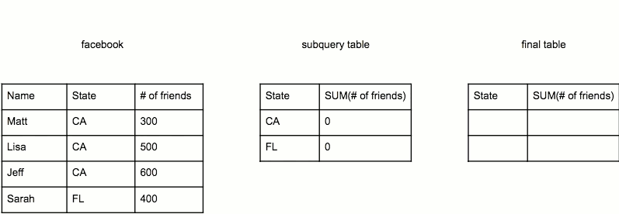
Class 4 Objectives
Subqueries
Notes:
Feynman technique: Learn -> Explain -> Reflect -> Repeat
What are the most important ideas from last class? Write a summary of the information as if explaining to a 14 year old. Avoid jargon Keep the words and sentences simple Rely on memory Make the explanation visual, if possible Note where you had difficulty or have knowledge gaps. These indicate things you should review, research, or ask questions about

Slide 5
What is the need for data manipulation?
Creating new datasets & Combine disparate data sets
Perform common queries, aggregations, and joins
Adding, removing, or modifying data
Extracting and Storing Data
Creation/Extraction
Transforming data
Manipulating data
Storage & Retrieval
Notes:
Creation: creating tables and databases, the things
Storage: where data are stored
Cleaning: adding, removing, or modifying data
Retrieval: selecting only the data you want

Slide 6
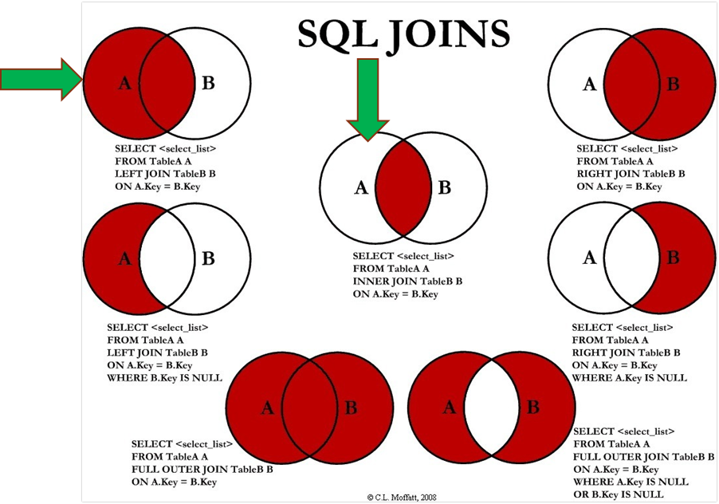
How do you combine data?
Answer:
SQL Joins can be done using WHERE or JOIN clauses!
Notes:
Most Common - INNER & LEFT, Sometimes Full Outer

Slide 7
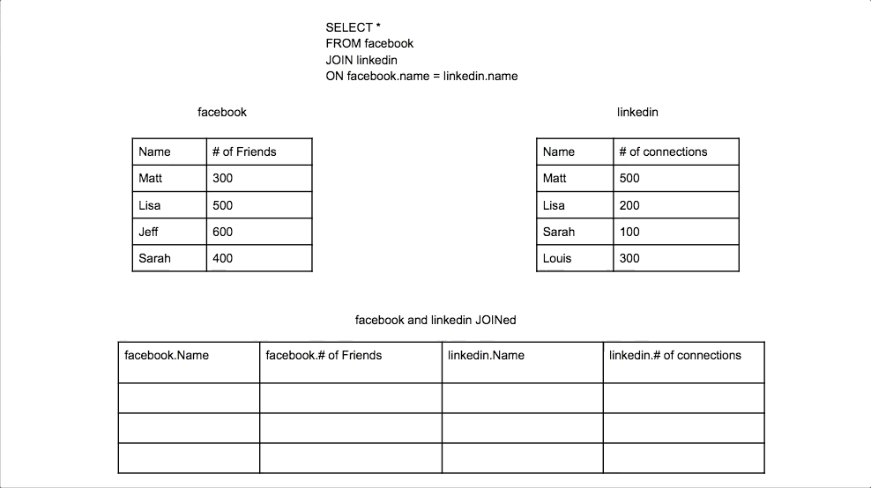
Inner Join
Syntax SELECT <columns> FROM <table> AS <alias> INNER JOIN <table> AS <alias2>
ON <alias>.<table column>
= <alias2>.<column>
Source: https://datapractices.org/courseware/2_7.html

Slide 8
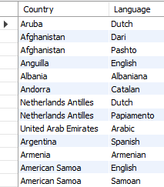
Inner Join - Example
Example - Official Languages SELECT a.`name` AS country, b.`language` FROM world.country as a INNER JOIN world.countrylanguage AS b ON a.code = b.countrycode and b.isofficial ='T'
Notes:
SELECT a.`code`, a.`name` AS country
FROM world.country AS a;
--run each part of the query then produce the final joined result
SELECT b.countrycode, b.`language`, b.isofficial
FROM world.countrylanguage AS b
WHERE b.isofficial ='T';
SELECT a.`name` AS country, b.`language`
FROM world.country AS a INNER JOIN world.countrylanguage AS b ON a.`code` = b.countrycode AND b.isofficial ='T'

Slide 9
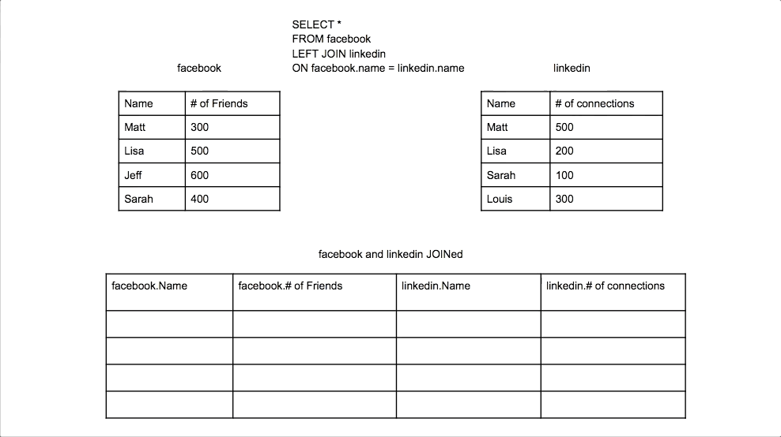
Left Join
Syntax SELECT <columns> FROM <table> AS <alias> LEFT JOIN <table> AS <alias2>
ON <alias>.<table column>
= <alias2>.<column>
Source: https://datapractices.org/courseware/2_7.html

Slide 10
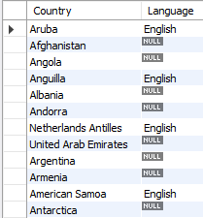
Left Join - Example
Question: “Which countries do/do not speak English as a language?”
Example
SELECT a.`name` AS country, b.`language` FROM world.country AS a LEFT JOIN world.countrylanguage AS b ON a.code = b.countryCode AND b.`Language` ='English'
Notes:
SELECT a.`code`, a.`name` AS country FROM world.country AS a;
SELECT b.countryCode, b.`language` FROM world.countrylanguage AS b
WHERE b.`Language` ='English’;
SELECT b.countryCode, b.`language`
FROM world.countrylanguage AS b
WHERE b.countrycode ='AFG’;
SELECT a.`name` AS country, b.`language`
FROM world.country AS a LEFT JOIN world.countrylanguage AS b ON a.`code` = b.countryCode AND b.`Language` ='English';

Slide 11

Full Outer Join
Syntax SELECT <columns> FROM <table> AS <alias> FULL OUTER JOIN <table> AS <alias2>
ON <alias>.<table column>
= <alias2>.<column>
Source: https://datapractices.org/courseware/2_7.html

Slide 12
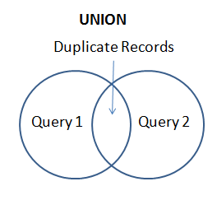
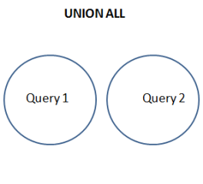
SQL Union & Union All
Purpose: The UNION operator is used to append the result-set of two or more SELECT statements.
Each SELECT statement within UNION must have the same number of columns
The columns must also have similar data types
The columns in each SELECT statement must also be in the same order

Slide 13
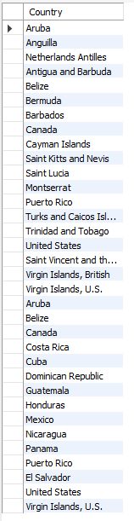
SQL Union All
Example
SELECT a.`name` as country
FROM world.country as a
INNER JOIN world.countrylanguage as b
ON a.`code` = b.countrycode AND b.`Language`='English’
WHERE a.Continent = 'North America’
UNION ALL
SELECT a.`name` as country
FROM world.country AS a
INNER JOIN world.countrylanguage AS b
ON a.`code` = b.countrycode AND b.`Language`='Spanish’
WHERE a.continent = 'North America'
Question: “List all countries in North America that speak English or Spanish as a language, with duplication.
/
Notes:
SELECT a.`name` AS country
FROM world.country AS a
INNER JOIN world.countrylanguage AS b
ON a.`code` = b.countrycode AND b.`Language`='English’’
WHERE a.Continent = 'North America’
UNION ALL
SELECT a.`name` AS country
FROM world.country AS a
INNER JOIN world.countrylanguage AS b
ON a.`code` = b.countrycode AND b.`Language`='Spanish’
WHERE a.continent = 'North America’

Slide 14
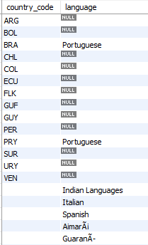
Full Outer Join - Example
Question: “List the names for all South American countries that speak/don’t speak Portugese,
while including all other languages”
MySQL Example
SELECT a.`code` AS country_code, b.`language`
FROM world.country AS a
LEFT JOIN world.countrylanguage AS b
ON a.`code`= b.countrycode AND b.`language`= 'Portuguese’
WHERE a.continent = 'South America’
UNION
SELECT ‘’ AS country_code, b.`language`
FROM world.country AS a
RIGHT JOIN world.countrylanguage AS b ON a.`code`=b.countrycode
WHERE a.continent = 'South America'
Notes:
SELECT a.`code` AS country_code, b.`language`
FROM world.country AS a
LEFT JOIN world.countrylanguage AS b ON a.`code`=b.countrycode and b.`language` = 'Portuguese'
WHERE a.continent = 'South America'
UNION
SELECT '' AS country_code, b.`language`
FROM world.country AS a
RIGHT JOIN world.countrylanguage AS b
ON a.`code`=b.countrycode
WHERE a.continent = 'South America'

Slide 15
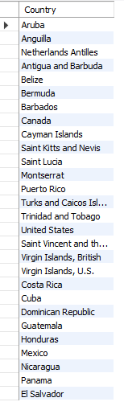
SQL Union
Example
SELECT a.`name` AS country
FROM world.country AS a
INNER JOIN world.countrylanguage as b
ON a.`code` = b.countrycode AND b.`Language`='English’
WHERE a.Continent = 'North America’
UNION
SELECT a.`name` as country
FROM world.country AS a
INNER JOIN world.countrylanguage AS b
ON a.`code` = b.countrycode AND b.`language`= 'spanish'
WHERE a.continent = 'North America'
Question:
“List all countries in North America that speak English or Spanish as a language, with no duplication.
Notes:
SELECT a.`name` AS country
FROM world.country AS a
INNER JOIN world.countrylanguage AS b
ON a.`code` = b.countrycode AND b.`Language`='English'
WHERE a.Continent = 'North America'
UNION
SELECT a.`name` as country
FROM world.country AS a
INNER JOIN world.countrylanguage AS b
ON a.`code` = b.countrycode AND b.`Language`='Spanish'
WHERE a.continent = 'North America'

Slide 16

Subqueries
A.K.A. nested queries, inner queries, inner select
Must be enclosed by parentheses
Ex: SELECT <col> FROM <table>WHERE (SELECT <col> FROM <table>);
Can return single value (aka scalar), single row, single column, or table
Evaluated inside-out
Also used in the SELECT or FROM clause!
Notes:
Comprehensive guide - https://www.w3resource.com/sql/subqueries/understanding-sql-subqueries.php
Select clause query:
SELECT customer.customer_num, (SELECT SUM(ship_charge)
FROM orders
WHERE customer.customer_num = orders.customer_num)
AS total_ship_chg
FROM customer

Slide 17
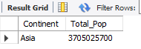
Example – FROM Clause
What is the total population of the continent of Asia?
SQL Query
SELECT subq.continent, SUM(subq.population) AS total_pop
FROM (
SELECT continent, `name` AS country, population
FROM world.country
WHERE continent = 'asia'
) AS subq #using subquery
GROUP BY subq.Continent
Notes:
SELECT continent, `name` AS country, populationFROM world.countryWHERE continent = 'asia';SELECT subq.continent, SUM(subq.population) AS total_popFROM (SELECT continent, `name` AS country, populationFROM world.countryWHERE continent = 'asia') AS subq #using subquery GROUP BY subq.Continent;

Slide 18
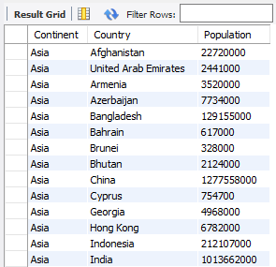
How did it work?
SQL “Inner” Query
SQL “Outer” Query
Summarize the Population of all Asian
Countries by Continent
SELECT subq.continent
, SUM(subq.population) as total_pop
select continent, `name` as country, population
from world.country
where continent = ‘asia'

Slide 19
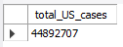
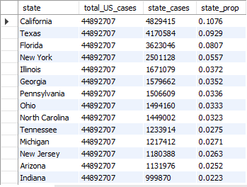
Example – SELECT Clause
What is the national vs. state proportions for Covid-19 cases, by Region?
Subquery
SQL Query
SELECT us.state
,(SELECT MAX(s1.cases) FROM covid_19.us AS s1) AS total_US_cases
,MAX(us.cases) AS state_cases, MAX(us.cases) /
(SELECT MAX(s1.cases) FROM covid_19.us AS s1) AS state_prop
FROM covid_19.us_states AS us
GROUP BY us.state
ORDER BY state_prop DESC
Result
Total US Covid-19 cases as of 10/15/21
US Total, State and County datasets available on Github: https://github.com/nytimes/covid-19-data/blob/master/us-counties.csv
Notes:
SELECT MAX(s1.cases) AS total_US_cases FROM covid_19.us AS s1 ; # subquery
SELECT us.state,
(SELECT MAX(s1.cases) FROM covid_19.us AS s1) AS total_US_cases #return single scalar value - running total by day
, MAX(us.cases) AS state_cases, MAX(us.cases) / (SELECT MAX(s1.cases) FROM covid_19.us AS s1) AS state_prop
FROM covid_19.us_states AS us
GROUP BY us.state
ORDER BY state_prop DESC;

Slide 20
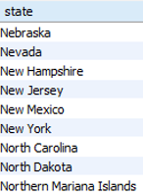
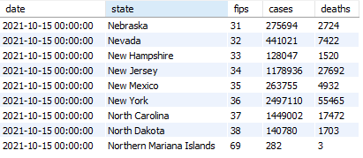
Example – WHERE Clause
Get current Covid-19 state-level info, for all states that begin with ‘N’
Subquery
SQL Query
SELECT q.*
FROM covid_19.us_states as q
WHERE state in (SELECT DISTINCT state FROM covid_19.us_states WHERE LEFT(state,1) = 'N’)
AND q.`date` = CAST('2021-10-15' AS DATE);
Result
Total US Covid-19 cases as of 10/15/21
US Total, State and County datasets available on Github: https://github.com/nytimes/covid-19-data/blob/master/us-counties.csv
Notes:
SELECT q.*
FROM covid_19.us_states as q
WHERE state in (SELECT DISTINCT state FROM covid_19.us_states WHERE LEFT(state,1) = 'N’)
AND q.`date` = CAST('2021-10-15' AS DATE); #note the date format when using CAST function

Slide 21
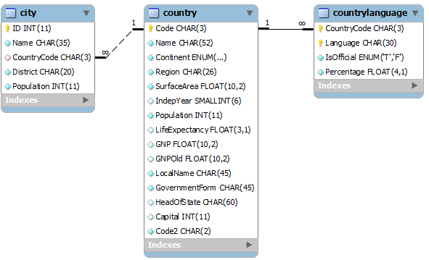
Exercises
SQL Joins, Unions & Subqueries
1. Using a union on the world.country table, combine all countries (repeating) with a life expectancy of > 80 years or a GNP > 1000000, with no repeats.
2. List all official languages spoken in the 'Southeast Asia' region.
3. List all the countries in North America, then match (left join) the “percentage” of the population that speaks English.
4. In the “world” schema, obtain the name of all cities in North America that have a population over 1M, where the primary language is English or Spanish (with repeats).
5. Subquery.sql Examples – Employees Database, Covid
Notes:
Schema: https://gist.github.com/mdang/9a4a8063ebea3b829b8025746643ade1

Slide 22
Project Milestones
Query Data for Data Understanding/Relevant Information (Class 2)
Storing and Import data into MySQL database (Class 3)
Merging and Joining data for analysis (Class 4)
Cleaning Data (Class 5)
Create Automated Processes using Stored Procedures & Functions (Class 6)
Normalize Data & Create Data Model (Class 7)
Analyze Data Quality & Create Data Dictionary (Class 8)
Finalize Project - Connect MySQL to PowerBI Cloud, Answer Business Questions (Class 8)

Slide 23

Class Project
SQL Joins, Unions, & Subqueries
To better understand the marketplace for video games and consoles, the COO would like to know the answer to the following questions:
What are the total sales for Action vs. Role-Playing games in North America by Year, since 2000?
During that time period, how does Role-Playing game sales compare vs. other Genres?
What is the most popular console (by NA_Sales) for Role Playing games, for consoles with a “first_retail_availablity” since 2000?
Obtain the average rank of games created in 2014, by genre. How does this order compare with other years?
Does this lead you to additional questions to research or data to gather?
Notes:
https://www.kaggle.com/max-mind/world-cities-database
https://www.kaggle.com/gregorut/videogamesales

Slide 24


